Slide 1

CSE 4616 • WIRELESS NETWORKS LAB • ASSIGNMENT 1
Impact of Traffic Load and Network Parameters on
IEEE 802.11 Wireless LAN Performance
Rahatut Tahrim Mounota
Student ID: 220041122
OMNeT++ with INET Framework v4.5.4 | seed-set = 220041122 | sim-time-limit = 40 s

Slide 2




Objectives & Evaluation Framework
Core Objective: Evaluate IEEE 802.11 WLAN performance under varying host density, contention, channel interference, and medium architecture, using discrete-event simulation in OMNeT++/INET.
Task 1 — MAC-Layer Saturation
Network saturation driven by CSMA/CA exponential-backoff retransmissions as host density rises.
Task 2 — Channel Interference
Physical-layer link degradation under variable background noise (SNIR vs. BER).
Task 3 — Wired vs. Wireless
Comparative benchmarking of wired Ethernet and wireless 802.11 under identical saturation load.
EVALUATED METRICS
PDR
Throughput
CWmin
End-to-End Delay
BER
CSE 4616 — Wireless Networks Lab, Assignment 1
2

Slide 3

Network Architecture & Simulation Topology
Wireless Segment: N stationary hosts in a 400 m × 400 m grid; RadioMedium background noise floor of –10 dBm; Ieee80211YansErrorModel.
SIMULATION TOPOLOGY — WiredAndWirelessHostsWithAP.ned
WirelessHost
→
AccessPoint
→
Router
→
wiredSinkNode
Access Point (ap): Bridges 802.11 wireless frames directly onto the wired Ethernet segment.
[0..N-1]
802.11↔Eth
aggregation
UdpSink:5000
Wired Segment: M WiredHost nodes connected via full-duplex 100 Mbps Ethernet (Eth100M).
WiredHost
→ direct to Router (Eth100M)
[0..M-1]
Traffic Destination: Unidirectional UDP flow to wiredSinkNode, listening on UDP port 5000.
All traffic converges on a single UDP sink, so wired and wireless segments are benchmarked under identical routing and traffic-generation conditions.
CSE 4616 — Wireless Networks Lab, Assignment 1
3

Slide 4
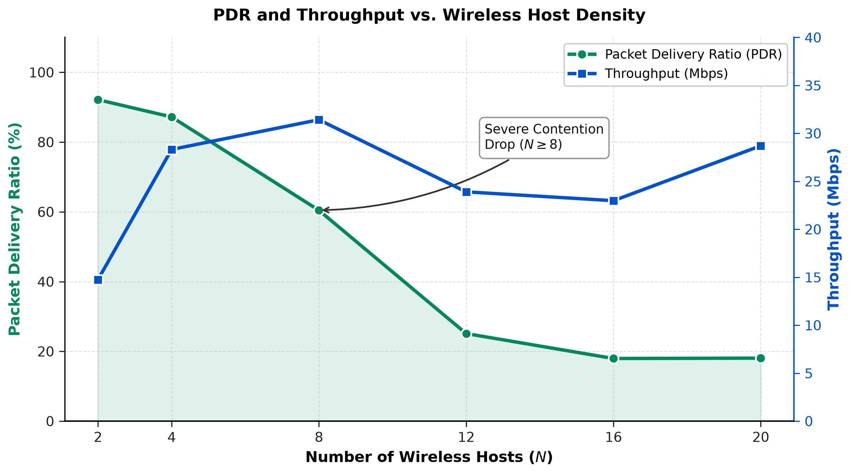
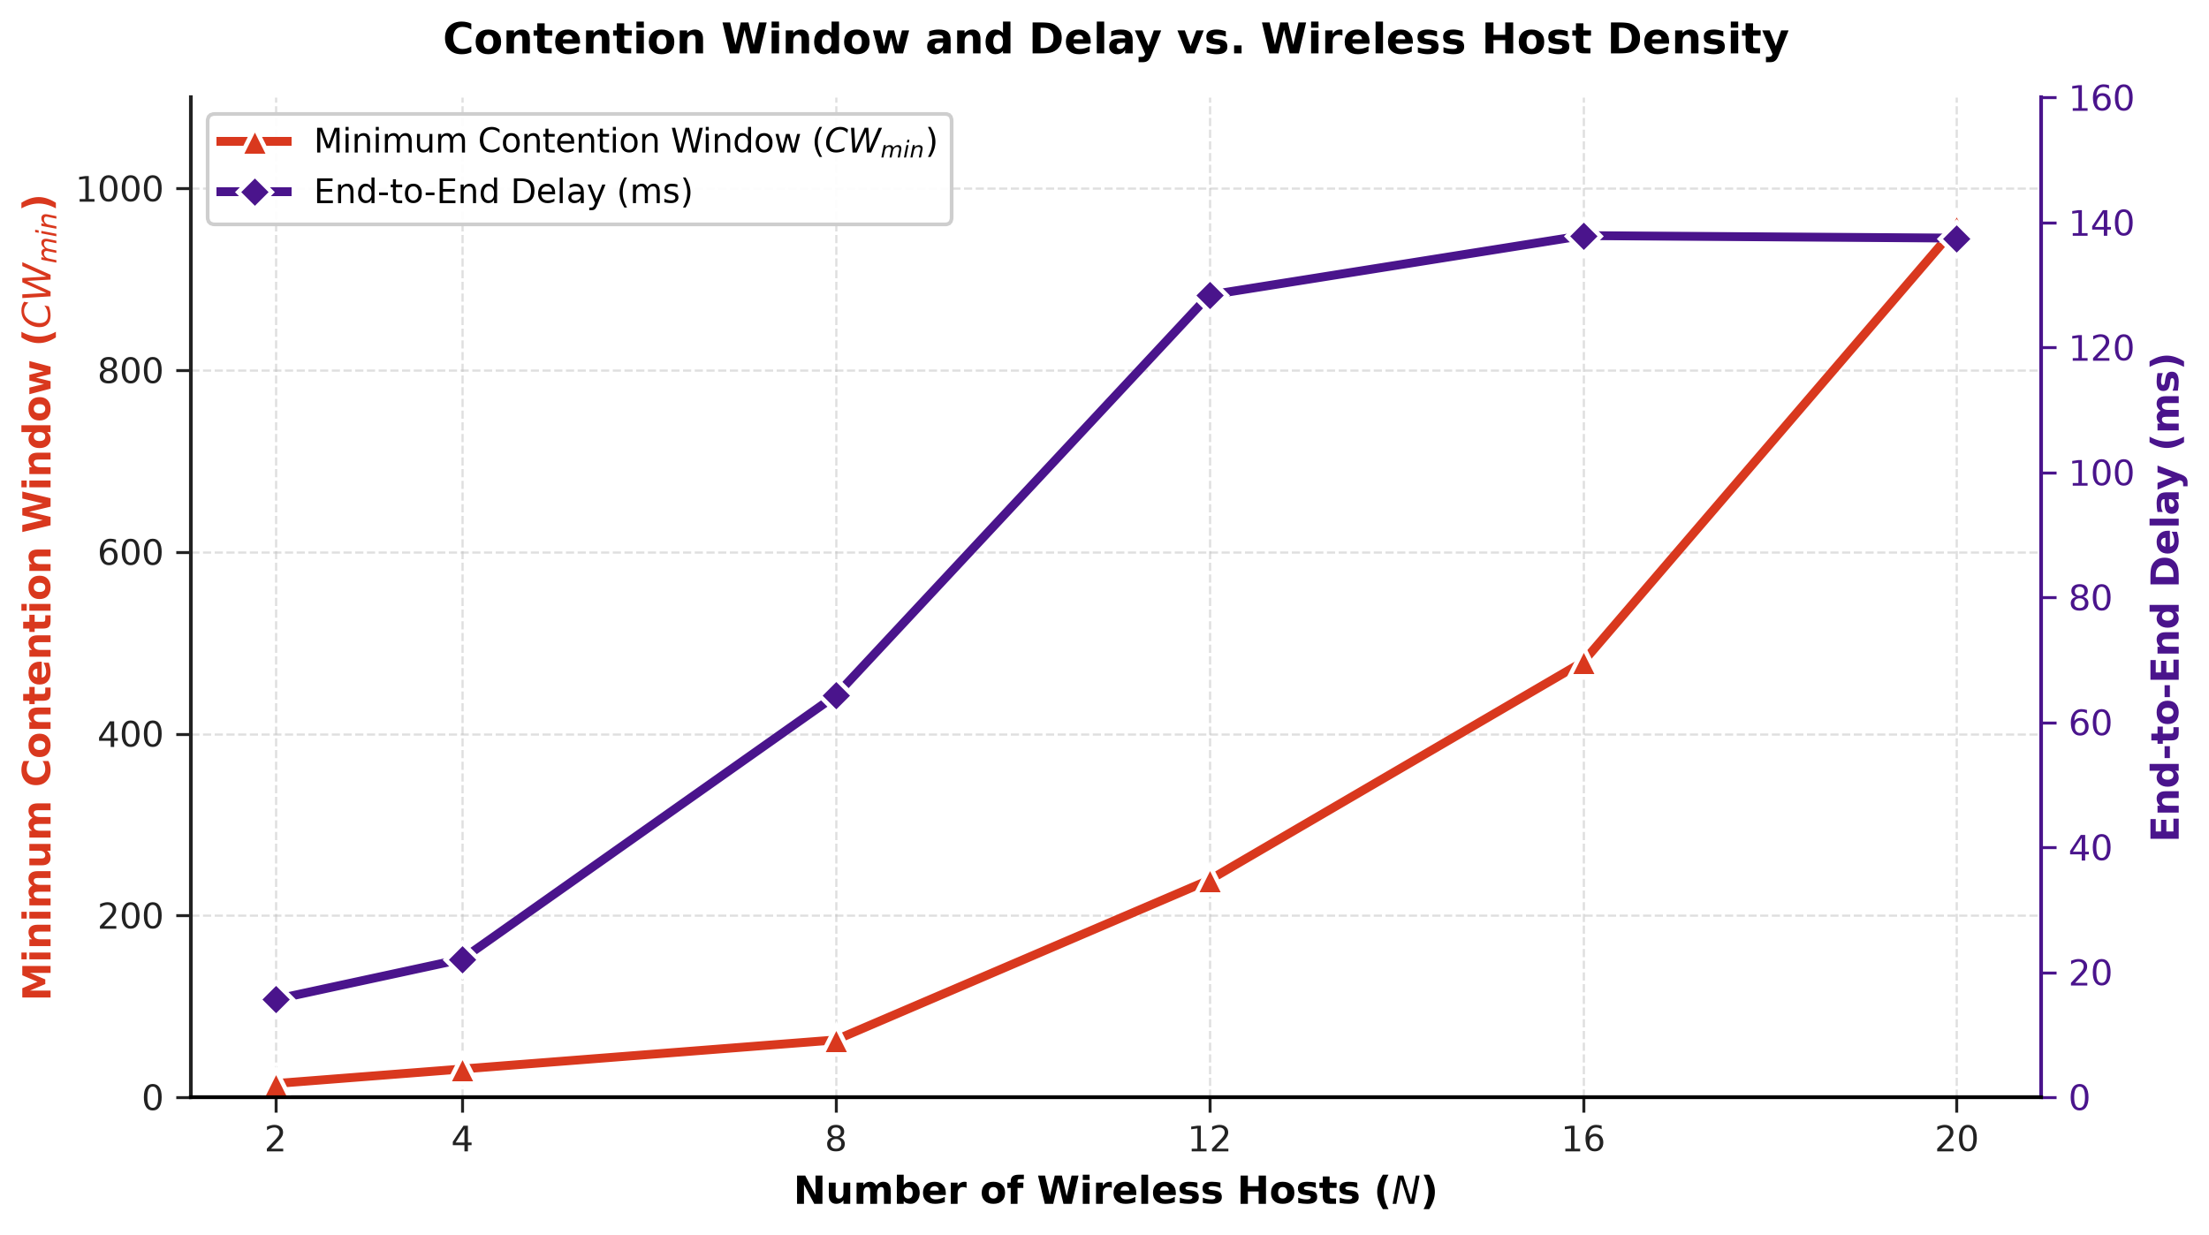
Task 1 — MAC Contention & Network Saturation
Offered Load: Cumulative Load (bps) = N × Packet Size (bits) / Send Interval (s) — 8 Mbps per host at a 0.001 s interval.
Low Load (N = 2, 16 Mbps)
Medium Load (N = 4–8)
Saturation Knee (N ≥ 8)
Minimal contention.
PDR reaches 92.30%
Delay just 15.71 ms.
Demand nears physical limits.
Throughput peaks at N = 8
(31.50 Mbps) as PDR falls to 60.45%.
Exponential backoff doubling.
CWmin: 15→31→63→960
PDR collapses to 18.00%.
Figure 1. PDR & Throughput vs. Wireless Host Density
Figure 2. Minimum Contention Window & Delay vs. Host Density
CSE 4616 — Wireless Networks Lab, Assignment 1
4

Slide 5
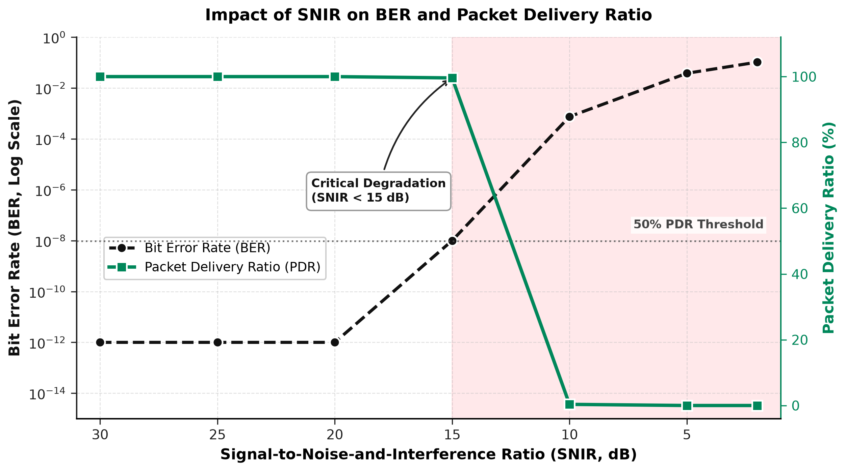



Task 2 — Channel Interference & SNIR Analysis
Setup: Fixed N = 10 hosts (≈40 Mbps offered load); background noise swept so SNIR ranges from 30 dB down to 2 dB.
BERtotal = [ (BERhdr × Lhdr) + (BERdata × Ldata) ] / (Lhdr + Ldata)
Optimal Region (SNIR ≥ 15 dB)
Near-zero BER; 100% PDR; throughput maxed at 31.50 Mbps.
Critical Degradation (SNIR < 15 dB)
Small per-bit error rises are amplified exponentially; frame success crosses the 50% PDR threshold.
Figure 3. Impact of SNIR on Bit Error Rate and Packet Delivery Ratio
Complete Failure (SNIR = 2 dB)
FCS failures dominate; PDR = 0.00%; delay hits the 500 ms retry ceiling.
CSE 4616 — Wireless Networks Lab, Assignment 1
5

Slide 6
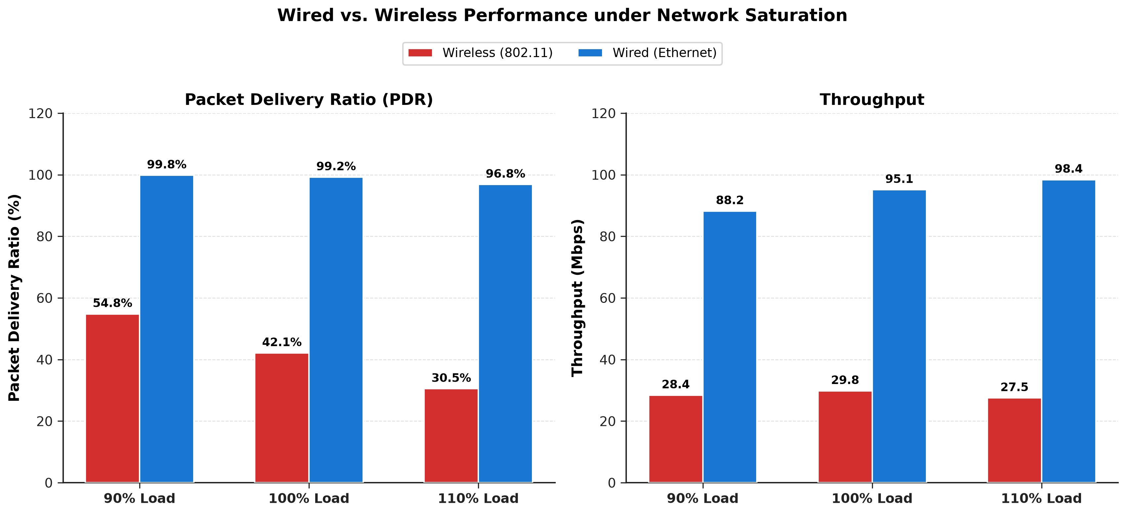
Task 3 — Wired vs. Wireless Saturation Comparison
Setup: Equivalent 160 Mbps offered load targeting a 100 Mbps bottleneck link, at 90%, 100%, and 110% overload factors.
Performance Characteristic | Wireless (802.11) | Wired (Ethernet)
Media Access Control | CSMA/CA (Half-Duplex) | Switched Ethernet (Full-Duplex)
Collision Overhead | High — wasted airtime on retries | Zero — isolated collision domains
100% Load PDR | 42.10% | 99.20%
100% Load Throughput | 29.80 Mbps | 95.10 Mbps
100% Load Delay | 88.40 ms | 1.20 ms
Figure 4. PDR and Throughput: Wired vs. Wireless under Saturation
Wireless capacity is bounded well below the wired ceiling at every load factor tested — the gap widens further under 110% overload.
CSE 4616 — Wireless Networks Lab, Assignment 1
6

Slide 7

Overall Statistical Summary
Aggregated across all simulation runs in Tasks 1–3.
PDR
THROUGHPUT
END-TO-END DELAY
BIT ERROR RATE
62.45%
32.10
185.30
0.0834
average
Mbps
ms
average
average
average
RANGE
RANGE
RANGE
RANGE
0.00% – 100.00%
0.00 – 95.40 Mbps
0.85 – 1420.50 ms
0.0000 – 0.4821
PRIMARY DRIVER
PRIMARY DRIVER
PRIMARY DRIVER
PRIMARY DRIVER
MAC collisions & background noise corruption
Physical link capacity & CSMA overhead
Retransmissions & queue backoff accumulation
Physical noise floor degradation
CSE 4616 — Wireless Networks Lab, Assignment 1
7

Slide 8



Key Conclusions & Recommendations
Collision Mitigation in High Density (N ≥ 8)
Enable RTS/CTS handshaking or increase the initial contention window (CWmin = 63) to prevent collision cascades.
Dynamic Link Adaptation
Implement adaptive Modulation and Coding Schemes (MCS) to maintain link stability when SNIR drops below 15 dB.
Network Planning
Use multi-channel Access Point deployments and 802.11e EDCA traffic prioritization to eliminate half-duplex wireless bottlenecks.
CSE 4616 — Wireless Networks Lab, Assignment 1
8

